Slide 1






COVID-19
Analysis
Presentation 2024
Presented By: Mohamed Atef

Slide 2

Agenda
Dataset Overview
Monthly Analysis
Spread Analysis
2020 vs 2021
Unique Countries

Slide 3





Dataset Overview
A brief introduction to the Dataset.
Present Columns
The dataset included 8 columns representing the number of confirmed, dead, and recovery cases with the date of the observation. There were also columns about the location like country_region, province, latitude, and longitude.
Total Observations
There was a total of 78386 observations and 121 different countries so there should be 647 observations per country. No NULL values were present, but a restriction for the NULL values was added for more safety.
Temporal Coverage
All the observations are between 1/22/2020 and 6/13/2021 so 18 months were covered while COVID-19 started in November 2019 and officially ended May 5th, 2023

Slide 4


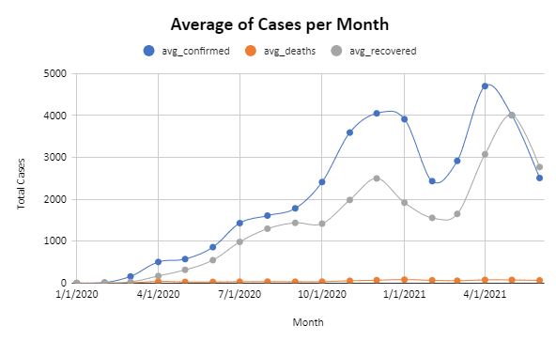
Monthly Analysis
The graph shows how the average of cases changed during the pandemic.
01
Rapid increase in confirmed caseson October 2020 & February 2021.
02
On April 2021 a sudden drop is noticeable. It may be because of vaccines
03
As any virus it starts to spread slowly then increases dramatically
04
The revoered cases line seems to follow the same trend as the confirmed cases.

Slide 5
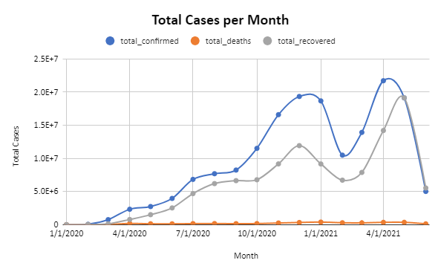
Total of Cases
The graph shows how the total of cases changed during the pandemic.
01
The previous graph seems to summarize show the general trend of this graph.
02
Notice how low the deaths graph is compared to the others indicated the low fatality rate .
03
Notice the significant change of y axis scale compared to the last graph indicated rapid spread of Corona virus.

Slide 6
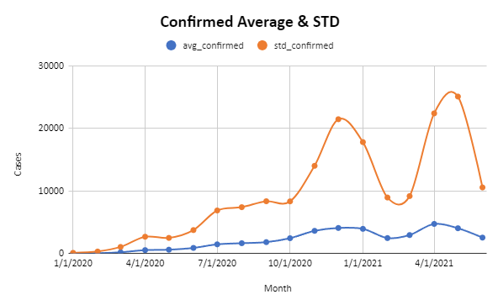
Confirmed Cases Analysis
01
The average line is shown before however the standard deviation shows that different countries had similar results.
02
We notice that there’s a significant change in the std curve.
03
A good conclusion can be that Corona virus spread differently all around the world.

Slide 7
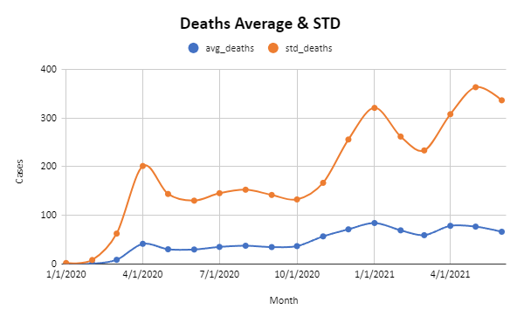
Death Cases Analysis
01
The low fatality rate of Corona virus can be seen here from the scale of the Y axis.
02
A new peak is noticed on March 2020 that’s not in the previous graphs.
03
The peak may be caused by infected people that didn’t know they had a serious disease or misclassified with a common cold.

Slide 8
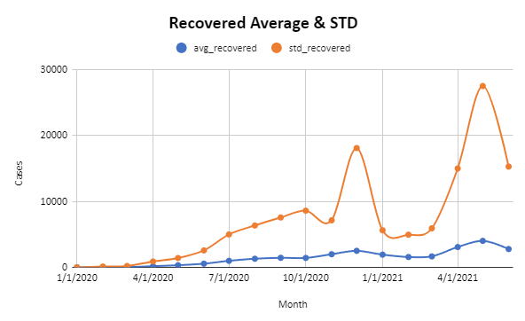
Recovered Cases Analysis
01
The two peaks shown can indicate the effectiveness of the introduced vaccines.
02
They can also indicate that with more experience with the virus medical institutions learned how to deal with it.

Slide 9

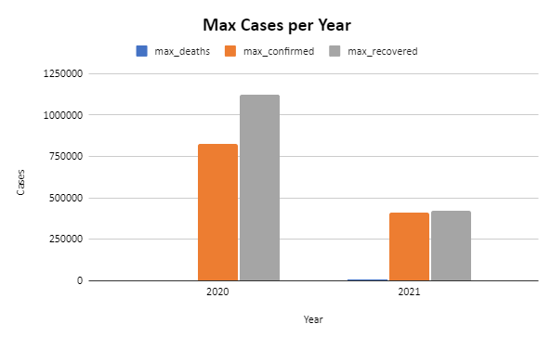



2020 vs 2021
A significant decrease in the maximum number of cases is shown and upon further inspection, we discover that vaccines for COVID-19 were introduced in 2020 which can cause the decrease we’re seeing.

Slide 10

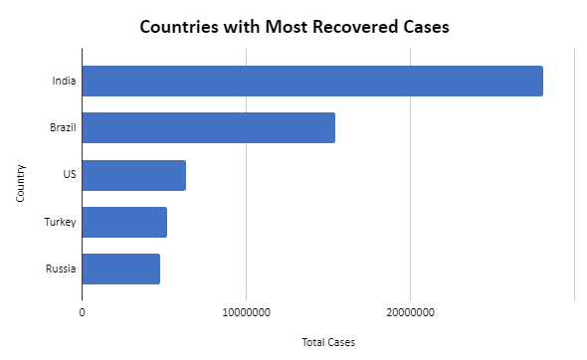
Unique Countries
Countries with distinguishable numbers
Most Confirmed Cases
(33461982)
Least Death Cases
(zero)
Dominica
USA
Marshall Islands
Kiribati
Samoa

Slide 11




Thank You
Calle Cualquiera 123, Cualquier Lugar

